Slide 1

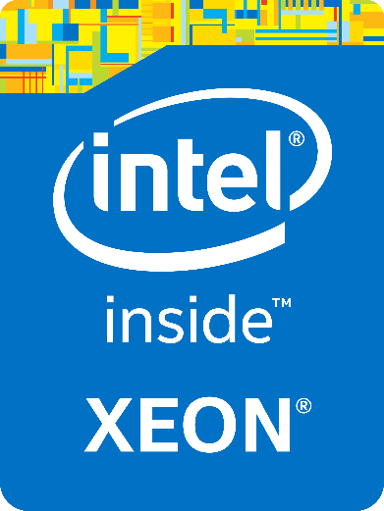

Intel® Xeon® Processor E5-2600 v3 Product Family The Fast Lane to Better Performance†
September 2014
Application Showcase:
Big Data/Analytics
How fast do you want to go?
† Better Performance is demonstrated through proof points in this presentation.

Slide 2
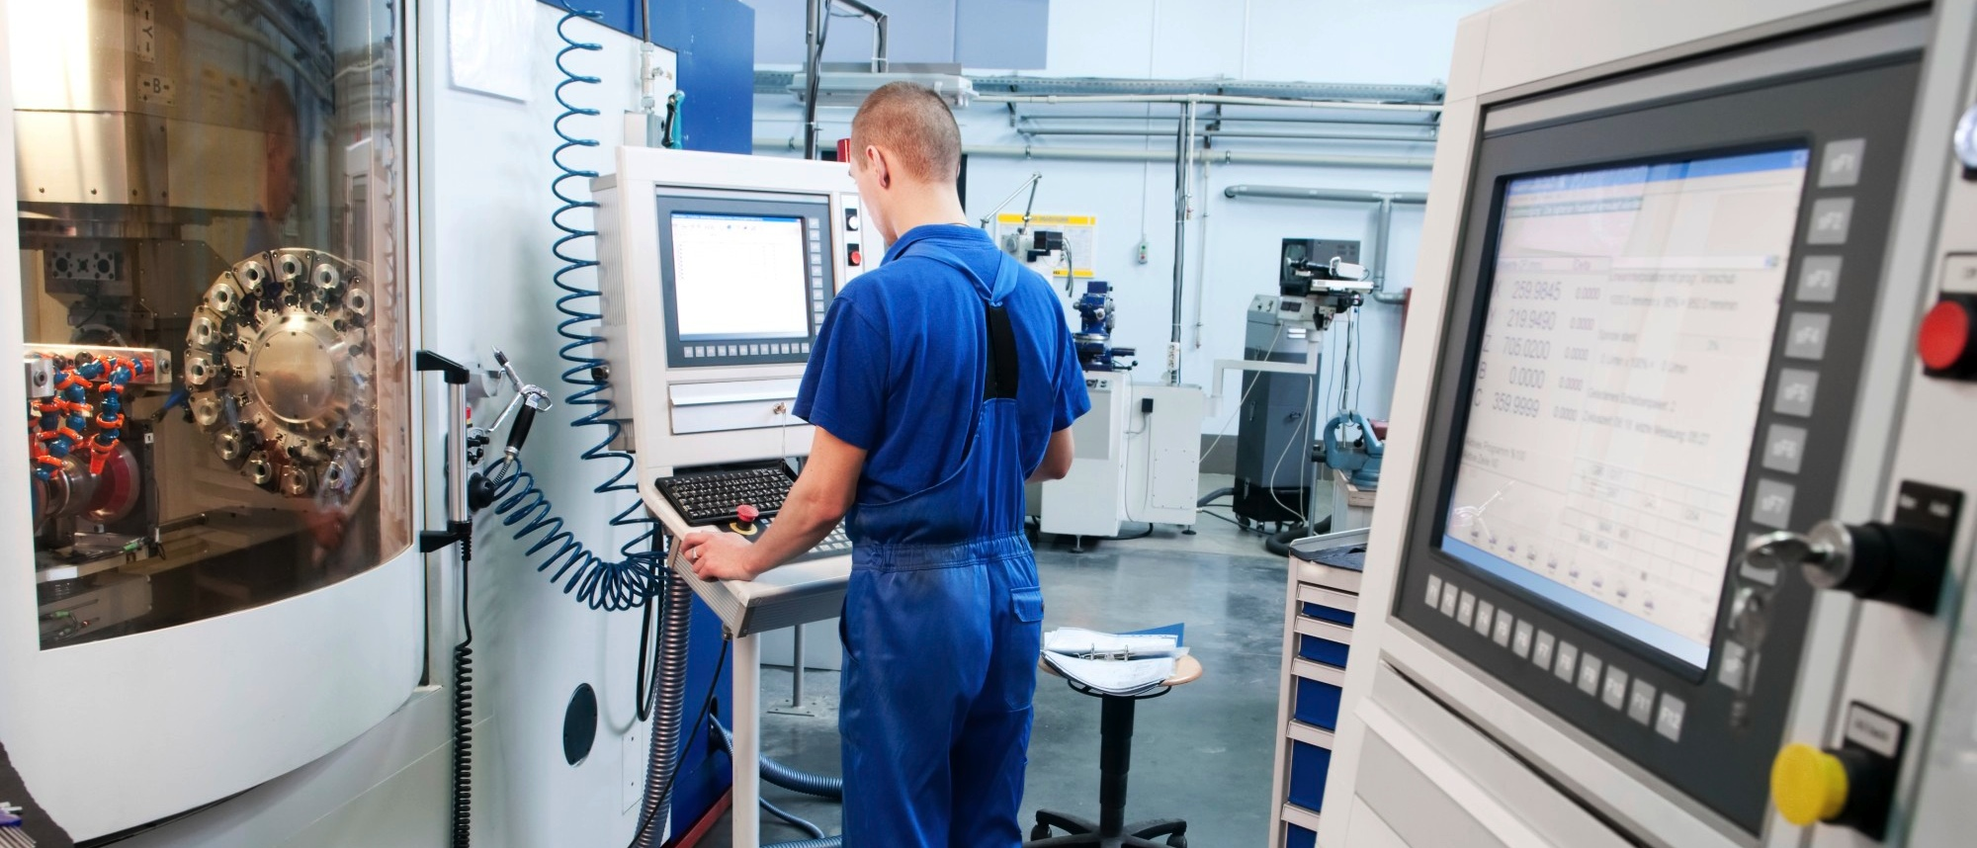

Big Data / Analytics
Copyright © 2014 Intel Corporation. All rights reserved. *Other names and brands may be claimed as the property of others.

Slide 3

Splunk*
Splunk Enterprise* - Concurrent users workload
“Intel® Xeon® processor E5-2600 v3 product family-based platforms are ideal to scale Splunk Enterprise* across multiple clusters/aggregators, providing exceptional insight into a wide variety of applications/machine data across the enterprise.”
Joyce Morrell - Senior Director, Developer Programs
Intel® Xeon® Processor E5-2600 v3 Product Family
www.splunk.com
Big Data/Analytics
Intel® SSD DC P3700 increased Splunk throughput rare-term searches by concurrent users by up to 312%
The Intel® Xeon® processor E5-2697 v3 provides up to 32% improvement for Splunk dense searches by concurrent users vs. the previous generation processor.¹
Intel® Solid-State Drive Data Center P3700 increased Splunk rare-term searches throughput up to 312% compared to Intel® SSD S3700.²
Splunk Enterprise monitors and analyzes customer clickstreams and transactions, to network activity and call records.
Up to
32% faster!
Performance increase
Performance increase
Splunk turns data into valuable insights, and with The Intel® Xeon® processor E5-2697 v3, it does it even better!
1 - Testing conducted on Splunk dense searches comparing Intel® Xeon® Processor E5-2697 v2 with Intel® Xeon® Processor E5-2697 v3. Testing done by Intel. For complete configuration details, go to www.intel.com/performance . 2 - Performance measured on increased Splunk rare-term searches throughput comparing Intel® SSD S3700 series with Intel® SSD P3700 series. Testing done by Intel. For complete configuration details, go to www.intel.com/performance.
Software and workloads used in performance tests may have been optimized for performance only on Intel microprocessors. Performance tests, such as SYSmark and MobileMark, are measured using specific computer systems, components, software, operations and functions. Any change to any of those factors may cause the results to vary. You should consult other information and performance tests to assist you in fully evaluating your contemplated purchases, including the performance of that product when combined with other products.
Copyright © 2014 Intel Corporation. All rights reserved. *Other names and brands may be claimed as the property of others.

Slide 4

SAS* - Intel® Better Together
Business Analytics* - Mixed workload; 36 Cores
“Performance and reliability are critical for SAS Analytics* applications. Teaming Intel® Xeon® Processor E5-2600 v3 and Intel® Solid-State Drive (Intel® SSD) P3700 delivers impressive performance gains – up to 3.02X over the previous generation processor and SSD with the SAS Mixed Analytics workload that closely resembles our customer implementations. The Intel® SSD P3700 is a great option for I/O intensive applications.”¹
Ken Gahagan - Director, SAS R&D
Intel® Xeon® Processor E5-2600 v3 Product Family
www.sas.com
Big Data/Analytics
SAS Analytics* mixed workload improvement (jobs-per-hour from 3.98 to 12.04) with Intel® Xeon® Processor E5-2600 v3 and Intel® SSD DC P3700
Up to 202% faster!!
SAS* applications provide an integrated environment for predictive and descriptive modeling, data mining, text analytics, forecasting, optimization, simulation, experimental design and more.
Performance increase
Intel® SSD | Product Specification of IO Throughput per SSD |  | Number of tested SSDs | Estimate Cost of a single SSD | Estimate Total cost of tested SSDs
800 GB S3700 | Read | 500 MB/s | 8 | $1,533 | $12,264
 | Write | 460 MB/s
1.6 TB P3700 | Read | 2800 MB/s | 2 | $5,095 | $10,190
 | Write | 2000 MB/s
Intel® SSD P3700 helps deliver up to 3.02X better performance for SAS Analytics!
1 - Testing conducted on SAS Business Analytics* jobs-per-hour comparing Intel® Xeon® Processor E5-2697 v2 with Intel® Xeon® Processor E5-2697 v3, and Intel® SSD DC S3700 series with Intel® SSD DC P3700 series. Testing done by Intel. For complete configuration details, go to www.intel.com/performance
Software and workloads used in performance tests may have been optimized for performance only on Intel microprocessors. Performance tests, such as SYSmark and MobileMark, are measured using specific computer systems, components, software, operations and functions. Any change to any of those factors may cause the results to vary. You should consult other information and performance tests to assist you in fully evaluating your contemplated purchases, including the performance of that product when combined with other products.
Copyright © 2014 Intel Corporation. All rights reserved. *Other names and brands may be claimed as the property of others.

Slide 5

AYASDI*
Data-Driven Analytics – Appliance under load workload; 36 Cores
“The combination of Intel® Xeon® processor E5-2699 v3 with Intel® Advanced Vector Extensions 2 (Intel® AVX2), Intel® Solid-State Drives (Intel® SSDs), Intel® Math Kernel Library (Intel® MKL) and Intel® Compiler has enabled us to improve the performance of our topological learning platform by up to 63%!”¹
Lawrence Spracklen - VP of Engineering at Ayasdi
Intel® Xeon® Processor E5-2600 v3 Product Family
www.ayasdi.com
Big Data/Analytics
Intel® Xeon® processor E5-2699 v3, Intel® AVX2, Intel® SSD 320 Series, Intel® MKL, and Intel® Compiler results in up to 63% faster AYASDI analytics performance (Metric: concurrent users at identical response times)
AYASDI transforms how organizations use their data to discover critical intelligence. AYASDI pioneered topological learning, based on a decade of DARPA and NSF-sponsored research, which uncovers hidden insights that traditional analytic techniques often miss in complex datasets. AYASDI software provides an interactive and visual experience to quickly pinpoint relevant patterns and features.
AYASDI users can better digest complex information, leading to improved operations management, a streamlined supply chain, and real-time adjustments to quality control, which ultimately improves the bottom line.
Up to 63% faster!!
Performance increase
Unlock the intelligence in your data!
1 - Testing conducted on AYASDi software comparing Intel® Xeon® Processor E5-2697 v2 with Intel® Xeon® Processor E5-2697 v3. Testing done by AYASDI. For complete configuration details, go to www.intel.com/performance.
Software and workloads used in performance tests may have been optimized for performance only on Intel microprocessors. Performance tests, such as SYSmark and MobileMark, are measured using specific computer systems, components, software, operations and functions. Any change to any of those factors may cause the results to vary. You should consult other information and performance tests to assist you in fully evaluating your contemplated purchases, including the performance of that product when combined with other products.
Copyright © 2014 Intel Corporation. All rights reserved. *Other names and brands may be claimed as the property of others.

Slide 6

Aerospike*
Flash-Optimized In-Memory NoSQL Database –
Transactions workload
““Aerospike* is the database of choice in real-time bidding - one of the most demanding low latency, high throughput applications on the Internet - as well as the user profile store, id-mapping store and distributed cache for web and mobile applications in retail, travel, telco and other industries. The first flash-optimized NoSQL database, Aerospike was built from the ground up to take advantage of the latest in multi-core, multi-SSD servers and Intel® Solid-State Drives.”¹
Brian Bulkowski - Co-Founder & CTO, Aerospike
Intel® Xeon® Processor E5-2600 v3 Product Family
www.aerospike.com
Big Data/Analytics
Aerospike completes 10s of millions of transactions per second, which increased 1.56X (Mps speed went from 1.6 to 2.5) with Intel® Xeon® processor E5-2697 v3
Up to 56% faster!!
The Intel® Xeon® processor E5-2697 v3 allows Aerospike* to deliver up to 2.5 million transactions per second on a single server.
Increased memory speed reduces communications overhead; 28-cores per two-socket server provides application scalability; Intel® Hyper-Threading Technology and Intel® Turbo Boost Technology provide much higher price performance.
Performance increase
The world’s first flash-optimized, in-memory, NoSQL database... Now open source! And faster!
1 - Testing conducted on Aerospike Database software comparing Intel® Xeon® Processor E5-2697 v2 with Intel® Xeon® Processor E5-2697 v3. Testing done by Intel. For complete configuration details, go to www.intel.com/performance.
Software and workloads used in performance tests may have been optimized for performance only on Intel microprocessors. Performance tests, such as SYSmark and MobileMark, are measured using specific computer systems, components, software, operations and functions. Any change to any of those factors may cause the results to vary. You should consult other information and performance tests to assist you in fully evaluating your contemplated purchases, including the performance of that product when combined with other products.
Copyright © 2014 Intel Corporation. All rights reserved. *Other names and brands may be claimed as the property of others.
Copyright © 2014 Intel Corporation. All rights reserved. *Other names and brands may be claimed as the property of others.

Slide 7

Altibase*
HDB* Database – Client requested queries workload; 36 Cores
“Intel® Xeon® processor E5-2699 v3 achieves more transactions and lower latency on HDB* in-memory DBMS system with increased cores and faster memory. The scalability of the architecture with Intel® AVX2 enabled us to get the performance boosted up. Customers can gain better HDB performance on an Intel® Xeon® processor E5-2699 processor v3 platform.”¹
Jae-nam Choi - Head of Altibase Research and Development
Intel® Xeon® Processor E5-2600 v3 Product Family
www.altibase.com
Big Data/Analytics
Altibase HDB* is highly optimized for in-memory computing to avoid database performance latency. Customers see more transactions and lower latency on HDB in-memory DBMS system with increased cores and faster memory. The scalability of the architecture with Intel® AVX2 and Intel® Compiler optimization enabled better performance.²
Users can get more powerful high-intensity, in-memory data processing power of HDB with the Intel® Xeon® processor E5-2699 v3.
With the Increased processor power and faster memory, it is possible to get more analysis results even faster, and customers experience full on-line analysis benefits.
Performance increase
Performance platform for in-memory database
1 - Testing conducted on Altibase HDB* software comparing Intel® Xeon® Processor E5-2697 v2 with Intel® Xeon® Processor E5-2699 v3. Testing done by Altibase. For complete configuration details, go to www.intel.com/performance.
Software and workloads used in performance tests may have been optimized for performance only on Intel microprocessors. Performance tests, such as SYSmark and MobileMark, are measured using specific computer systems, components, software, operations and functions. Any change to any of those factors may cause the results to vary. You should consult other information and performance tests to assist you in fully evaluating your contemplated purchases, including the performance of that product when combined with other products.
Copyright © 2014 Intel Corporation. All rights reserved. *Other names and brands may be claimed as the property of others.
Copyright © 2014 Intel Corporation. All rights reserved. *Other names and brands may be claimed as the property of others.

Slide 8
SAS*
SAS Analytics* – Comp workload; 36 Cores
“Performance and reliability are critical for SAS Analytics*. The Intel® Xeon® processor E5-2699 v3 delivers impressive performance gains – up to 1.22X over the previous generation with the SAS Mixed Analytics* workload that closely resembles our customer implementations. The performance improvement from SAS9.3 to SAS9.4 is 1.06X with the new processor. This is a great platform for next-generation deployments.”¹
Ken Gahagan - Director, SAS R&D
Intel® Xeon® Processor E5-2600 v3 Product Family
www.sas.com
Big Data/Analytics
SAS Analytics* 9.4 performance increase (jobs-per-hour from 18.75 to 22.81) with Intel® Xeon® processor E5-2699 v3
SAS* applications provide an integrated environment for predictive and descriptive modeling, data mining, text analytics, forecasting, optimization, simulation, experimental design and more.
With the Intel® Xeon® processor E5-2699 v3, customers can run more complex analyses in less time and across larger data sets to gain deeper insight into critical business issues.
Performance increase
Speed time to insight for better decision making!
1 - Testing conducted on SAS Business Analytics* jobs-per-hour comparing Intel® Xeon® Processor E5-2697 v2 with Intel® Xeon® Processor E5-2699 v3. 2. Testing done by Intel. For complete configuration details, go to www.intel.com/performance.
Software and workloads used in performance tests may have been optimized for performance only on Intel microprocessors. Performance tests, such as SYSmark and MobileMark, are measured using specific computer systems, components, software, operations and functions. Any change to any of those factors may cause the results to vary. You should consult other information and performance tests to assist you in fully evaluating your contemplated purchases, including the performance of that product when combined with other products.
Copyright © 2014 Intel Corporation. All rights reserved. *Other names and brands may be claimed as the property of others.

Slide 9
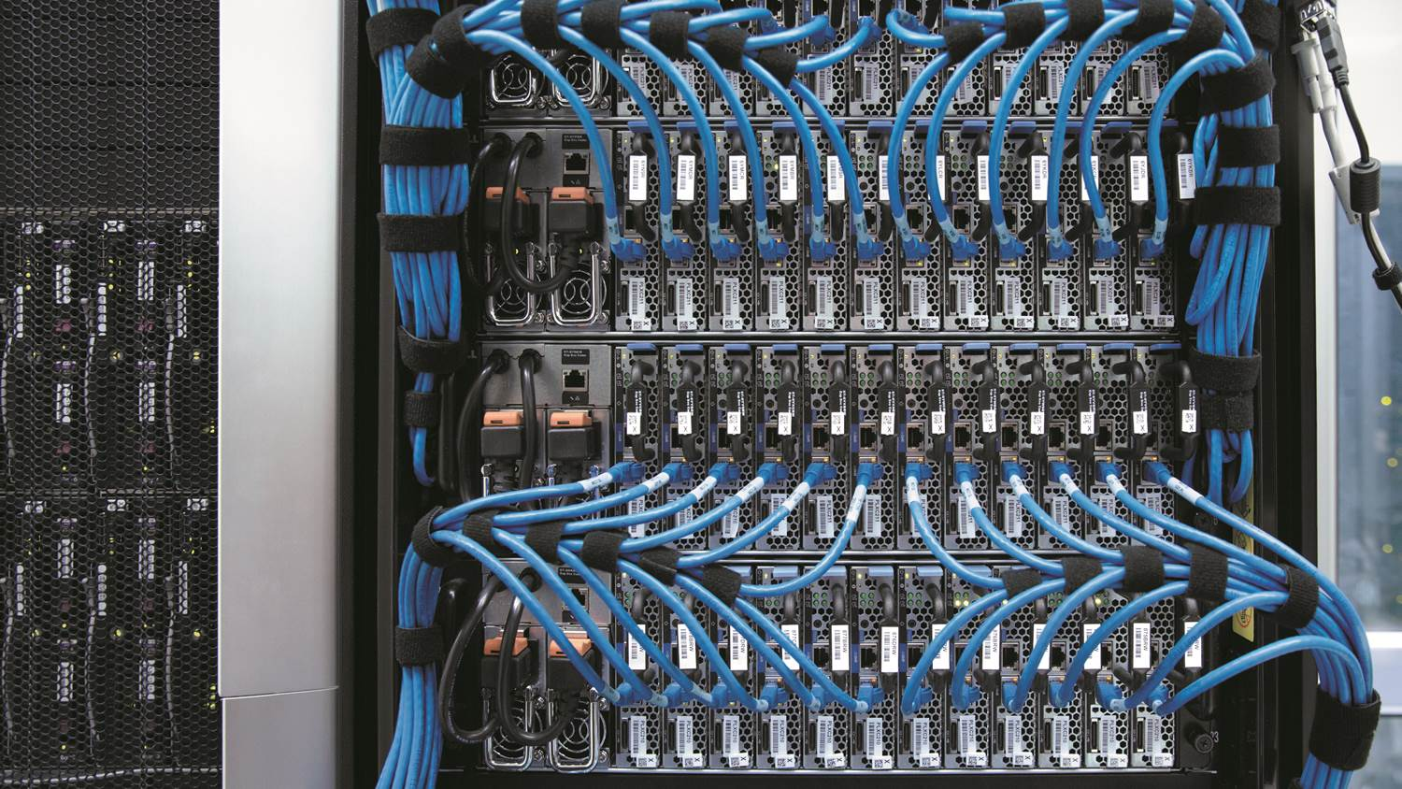

Economic Headwinds Have Put Pressure on IT Budgets
Infrastructure is aging and holding companies back.
IT must enable business innovation while also cutting costs.
This creates a key challenge for business competitiveness and growth.
Notes:
Key Message:
Organizations today are challenged to find the right balance between cutting costs and deploying modern IT infrastructure to support ever-evolving market demands.

Slide 10
Aging Infrastructure is Inefficient and Costly
> 4 YEARS OLD
26
32% of Servers are
>4 Years Old¹
32
%
%
CAPEX
74
1* Source: Intel analysis, 2012
2* Source: Gartner, IT Metrics: Align IT Investment Levels With Strategy Using Run, Grow, Transform and Beyond (March 2012)
Software and workloads used in performance tests may have been optimized for performance only on Intel microprocessors. Performance tests, such as SYSmark and MobileMark, are measured using specific computer systems, components, software, operations and functions. Any change to any of those factors may cause the results to vary. You should consult other information and performance tests to assist you in fully evaluating your contemplated purchases, including the performance of that product when combined with other products.
For more information go to http://www.intel.com/performance
%
OPEX
> 4 YEARS OLD
Make up only 4% of
Total Performance
Capabilities of Servers¹
4
%
Business innovation throttled to 26%²
Time to revenue
Cost of lost time, effort, opportunity
Unpredictable business cycles
74% captive in operations and maintenance²
Rigid & aging infrastructure
Application & information complexity
Inflexible business processes
> 4 YEARS OLD
65
%
Use 65% of Total
Energy Consumption¹
Notes:
Key Message:
Net-Net: 32% of the world’s servers only contribute 4% of the total performance but use 65% of the total power. These servers are greater than 4 years old

Slide 11

An Approach to Infrastructure Modernization
MODEL
Compare business requirements to vendor offerings
Identify application interoperability issues across the solution stack
Determine where applications will be hosted (virtual, physical, cloud)
Define the hardware components to retain, upgrade, and acquire
EXPLORE
Determine business requirements
Identify utilization and growth in servers, network, and storage
Identify software (custom or COTS)
Diagram infrastructure architecture
Determine costs and cost trends
 Infrastructure Modernization Methodology 
2 - 4 year cycle
PLAN
EXECUTE
MODEL
EXPLORE
Business Process Modeling
Program Management
PLAN
Determine site requirements for hosting hardware
Assign applications and development environments to hardware
Define network architecture and storage requirements
Assess ability of new architecture to meet compute requirements
Develop project plan with timeline and costs
EXECUTE
Configure new hardware and install new operating system and applications
Test functionality and acceptance with select users
Establish backup and disaster recovery functionality
Release to users
Plan for new upgrade cycle
Notes:
Key Message:
Modernizing the IT infrastructure is a process. Here is a diagram showing an application modernization methodology, and the key phases and considerations. This is an ongoing cycle that should be completed every 2 to 4 years.

Slide 12

The Journey Starts with a Strong Foundation
Take advantage of new capabilities in hardware and software to support business growth
Minimize operating expenses, maximize efficiency
Ensure security and compliance
Notes:
Key Message:
Start by updating your IT infrastructure to minimize operating expenses and maximize efficiency, taking advantage of new capabilities in hardware and software.
Additional Detail:
Extraordinary demands require extraordinary innovation
Intel is actively working with the industry to come up with creative and innovative solutions to meet this insatiable demand for compute in high performance computing
Intel is investing in three key areas… New CPU architectures, New Software & Tools, and Fabrics… …for a balanced platform approach… designed to keep up with the aggressive pursuit of computational capability

Slide 13

Effective IT Empowers Business Success
Companies that have invested in IT to achieve operational excellence and innovation are seeing tremendous benefits.
Companies that integrate IT into the business to deliver differentiated services and value for their customers are thriving.
Notes:
Key Message:
Organizations that utilize IT as a strategic enabler for operational excellence and differentiated services have a distinct competitive advantage.

Slide 14



The Path to Transformational IT Data Center Optimization
Modernize
Service Delivery
Deliver new services on demand
Use private, public, or hybrid cloud
Develop APIs and service- oriented architecture


Open Standards Based

Create New
Business Opportunities
Use big data to identify opportunities and respond to competitive threats
Optimize operations that improve time to market and predictive analytics
Enhance customer value with new products and services
Increase Operational
Efficiency
Minimize operating expenses and maximize efficiency
Take advantage of new capabilities in hardware and software
Ensure security and compliance
Ensure reliability to enhance service quality (nonstop services, VoIP, XoIP, etc.)

14
Notes:
Key Message:
There is a clear path to IT leadership: It starts with getting your IT environment in order and reducing costs while maximizing performance, security, and compliance.
Delivering a cloud infrastructure compounds costs savings, while enabling a flexible, service-based IT model.
From there, you can create new business opportunities and embrace new workloads like big data.
Additional Detail:
What is your balance in these three buckets?
Do you think of your IT in these 3 buckets?
How do you free up $$ from operating expenses to focus on modernized service delivery and new business opportunities?

Slide 15


Unlock the Potential of Big Data
Integrate your organizational processes with end-to-end analytics powered by Intel infrastructure technologies that can accelerate Apache Hadoop*.
Transform/ Analyze  Compute


DATA
Move  Network
Persist  Storage


Notes:
Key Message:
To achieve insights from big data, you need the compute, network, and storage resources required to process large amounts of data.
Additional Information:
The process of manipulating data has some common attributes. It’s likely that you are gathering your data from edge devices, the cloud, or other information sources. Once the data is in your environment, there are three major components of data management.
You will need compute resources to analyze and transform data. Inside the box, this takes the form of data analytics, In-Memory DB, or standard data processing. Outside the box, the data warehouse is transforming the modern enterprise data center. Compute is clearly the major component of analytics for insight, but there are more needs.
A solid network is necessary to move the data to the analytics engine. In some cases, networks and datacenter topologies actually move the analytics engines closer to the data, which reverses the normal trend. Having a good network is key to getting the most out of your data.
Finally, there’s a necessity to store or persist your data in a format that enables you to quickly gain insight. The structure of your data store along with the nearness of the analytics engines make all the difference in garnering information in minutes versus hours.
Intel is a leading supplier of silicon and systems. Additionally, we are growing our software competencies in Big Data. We can be a trusted advisor to you as you begin to scope your Big Data and analytics deployments.

Slide 16
Solutions that Work Better Together
2014
SAP ERP*
Intel® Xeon® Processor E5-2600 v3 Product Family
2014
Better Together
Up to 3X performance³
Improve querying speed
Support more users³
Software Upgrade
+ SAP EHP5*
+ IBM DB2* 10
Fast queries with automatic optimizations
Efficient indexing
SAP and SAP NetWeaver are the registered trademarks of SAP AG in Germany and in several other countries. See www.sap.com/benchmark for more information.
Software and workloads used in performance tests may have been optimized for performance only on Intel microprocessors. Performance tests, such as SYSmark and MobileMark, are measured using specific computer systems, components, software, operations and functions. Any change to any of those factors may cause the results to vary. You should consult other information and performance tests to assist you in fully evaluating your contemplated purchases, including the performance of that product when combined with other products.
For more information, visit intel.com/performance
*1,2,3,4 + Configuration details and additional information on the following page.
2010
Baseline
SAP EHP4* +
IBM DB2* 9.7
Intel® Xeon® Processor X5690
Hardware Upgrade
+ Intel® Xeon® Processor E5-2699 v3
Increased parallelism with up to 18 cores
Intel® AVX2 delivers up to 4x DP FLOPS/core and supports 2x wider vector integer instructions¹
Up to 2.7x memory capacity²
Benchmark: SAP* SD 2-tier
*Other names and brands may be claimed as the property of others.

Slide 17
Configuration Details for SAP* and Intel® Xeon® Processor E5-2600 v3 Product Family
Processor | Intel® Xeon® Processor X5690 (6C, 3.46 GHz, 130W) | Intel® Xeon® Processor E5-2699 v3 (18C, 2.3 GHz, 145W)
Sockets | 2 | 2
Memory | 96 GB | 256 GB
SAP* enhancement package | SAP* enhancement package 4 for SAP ERP 6.0 | SAP* enhancement package 5 for SAP* ERP 6.0
OS | Windows Server* 2008 Enterprise Edition | Windows Server* 2012 R2
Database | IBM DB2* 9.7 | IBM DB2* 10
SAP SD benchmark users | 5,100 | 16,000²
1* The Intel® Xeon® processor E5 product family supports Intel® Advanced Vector Extensions (Intel® AVX), which increases maximum vector size from 128 to 256 bits. Compared to the Intel® Xeon® processor 5600 series, Intel AVX enables up to twice the work to be accomplished per clock cycle during floating point and vector operations.
2* Up to 2.7X memory capacity based on a 2-socket platform: Intel® Xeon® processor X5600 series supports 18 DIMMS, max memory per DIMM of 32 GB RDIMM; Intel® Xeon® processor 2600v3 family supports 24 DIMMs, max memory per DIMM of 64GB RDIMM. This enables 2.7x the memory.
3* Up to 3x performance improvement based as of September 8, 2014 on SAP SD 2-tier workload comparing baseline IBM System x3650 M3 with two Intel® Xeon® Processor X5690 using SAP EHP 4 for ERP 6.0 scoring 5100 to the IBM System x3650 M5 platform platform with two Intel Xeon Processor E5-2699 v3 (18 cores, 36 threads), Windows Server 2012 R2, IBM DB2 10, SAP enhancement package 5 for SAP ERP 6.0, number of SAP SD benchmark users: 16,000. The SAP certification number was not available at press time and can be found at the following Web page: www.sap.com/benchmark.
*Other names and brands may be claimed as the property of others.

Slide 18
Legal Disclaimer
All products, computer systems, dates, and figures specified are preliminary based on current expectations, and are subject to change without notice.
Intel processor numbers are not a measure of performance. Processor numbers differentiate features within each processor family, not across different processor families. Go to: http://www.intel.com/products/processor_number
Intel, processors, chipsets, and desktop boards may contain design defects or errors known as errata, which may cause the product to deviate from published specifications. Current characterized errata are available on request.
SPEC, SPECpower, and SPECjbb are trademarks of the Standard Performance Evaluation Corporation. See http://www.spec.org (http://www.spec.org/) for more information.
TPC Benchmark is a trademark of the Transaction Processing Council. See http://www.tpc.org for more information.
Requires a system with Intel® Turbo Boost Technology. Intel Turbo Boost Technology and Intel Turbo Boost Technology 2.0 are only available on select Intel® processors. Consult your PC manufacturer. Performance varies depending on hardware, software, and system configuration. For more information, visit http://www.intel.com/go/turbo
Intel, Intel Xeon, the Intel Xeon logo, Intel Atom and the Intel logo are trademarks or registered trademarks of Intel Corporation or its subsidiaries in the United States and other countries. Other names and brands may be claimed as the property of others.
*Other names and brands may be claimed as the property of others.
Copyright © 2014, Intel Corporation. All rights reserved.
Copyright © 2014 Intel Corporation. All rights reserved. *Other names and brands may be claimed as the property of others.

Slide 19
Legal Disclaimers: Performance
Performance tests and ratings are measured using specific computer systems and/or components and reflect the approximate performance of Intel products as measured by those tests. Any difference in system hardware or software design or configuration may affect actual performance. Buyers should consult other sources of information to evaluate the performance of systems or components they are considering purchasing. For more information on performance tests and on the performance of Intel products, Go to: http://www.intel.com/performance/resources/benchmark_limitations.htm. and www.intel.com/software/products
Intel does not control or audit the design or implementation of third party benchmarks or Web sites referenced in this document. Intel encourages all of its customers to visit the referenced Web sites or others where similar performance benchmarks are reported and confirm whether the referenced benchmarks are accurate and reflect performance of systems available for purchase.
Relative performance is calculated by assigning a baseline value of 1.0 to one benchmark result, and then dividing the actual benchmark result for the baseline platform into each of the specific benchmark results of each of the other platforms, and assigning them a relative performance number that correlates with the performance improvements reported.
INFORMATION IN THIS DOCUMENT IS PROVIDED “AS IS”. NO LICENSE, EXPRESS OR IMPLIED, BY ESTOPPEL OR OTHERWISE, TO ANY INTELLECTUAL PROPERTY RIGHTS IS GRANTED BY THIS DOCUMENT. INTEL ASSUMES NO LIABILITY WHATSOEVER AND INTEL DISCLAIMS ANY EXPRESS OR IMPLIED WARRANTY, RELATING TO THIS INFORMATION INCLUDING LIABILITY OR WARRANTIES RELATING TO FITNESS FOR A PARTICULAR PURPOSE, MERCHANTABILITY, OR INFRINGEMENT OF ANY PATENT, COPYRIGHT OR OTHER INTELLECTUAL PROPERTY RIGHT.
Copyright © 2014 Intel Corporation. All rights reserved. *Other names and brands may be claimed as the property of others.

Slide 20
Legal Disclaimers: Performance
Intel® Advanced Vector Extensions 2 (Intel® AVX2): Intel® Advanced Vector Extensions 2 (Intel® AVX2) provides higher throughput to certain processor operations. Due to varying processor power characteristics, utilizing AVX instructions may cause a) some parts to operate at less than the rated frequency and b) some parts with Intel® Turbo Boost Technology 2.0 to not achieve any or maximum turbo frequencies. Performance varies depending on hardware, software, and system configuration and you can learn more at http://www.intel.com/go/turbo.
Intel® Hyper-Threading Technology (Intel® HT Technology): Available on select Intel® processors. Requires an Intel® HT Technology-enabled system. Your performance varies depending on the specific hardware and software you use. Learn more by visiting http://www.intel.com/info/hyperthreading.

Slide 21
Optimization Notice
Intel's compilers may or may not optimize to the same degree for non-Intel microprocessors for optimizations that are not unique to Intel microprocessors. These optimizations include SSE2, SSE3, and SSSE3 instruction sets and other optimizations. Intel does not guarantee the availability, functionality, or effectiveness of any optimization on microprocessors not manufactured by Intel. Microprocessor-dependent optimizations in this product are intended for use with Intel microprocessors. Certain optimizations not specific to Intel microarchitecture are reserved for Intel microprocessors. Please refer to the applicable product User and Reference Guides for more information regarding the specific instruction sets covered by this notice.
Notice revision #20110804
Copyright © 2014 Intel Corporation. All rights reserved. *Other names and brands may be claimed as the property of others.

Slide 22
Copyright © 2014 Intel Corporation. All rights reserved. *Other names and brands may be claimed as the property of others.

Slide 23
声明：
所有的版权属于原有公司，文件均来自公开渠道
此文件仅供学习使用，任何人不得进行以此为商业目的的行为
如有疑问，请立即删除
学习世界五百强和咨询公司PPT课程请访问如下网站搜索：“司马懿”
百度传课：司马懿PPT学校
https://www.chuanke.com
网易学堂：司马懿PPT学校
https://study.163.com
知乎： 司马懿PPT学校
https://www.zhiu.com

